Slide 1



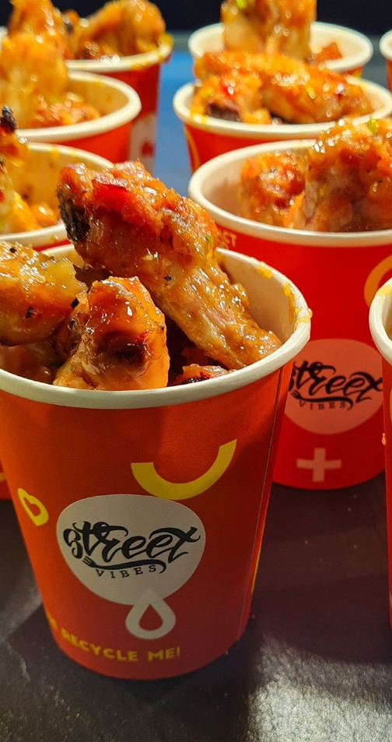
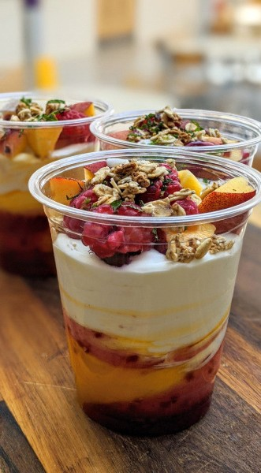
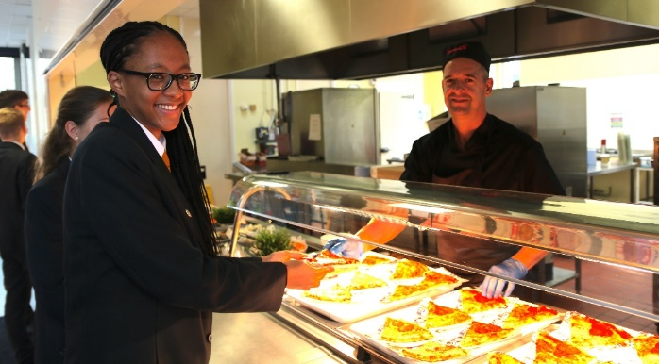
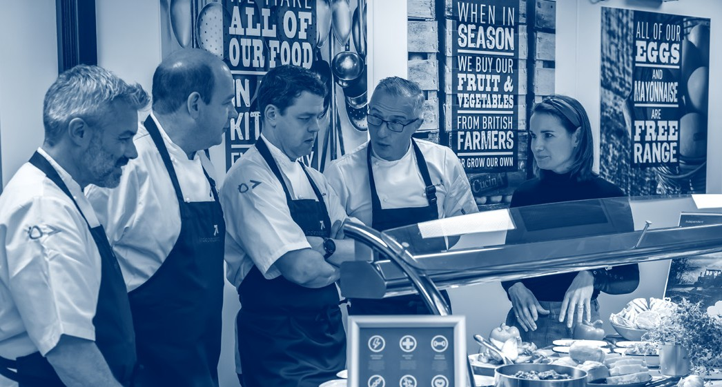
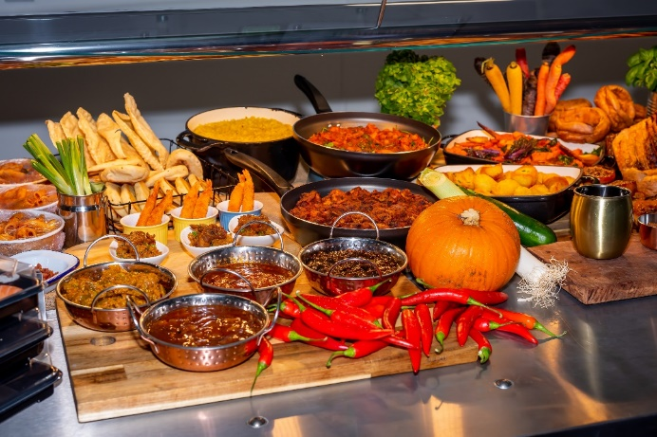

We are delighted to partner with the students, teachers, and staff at Durrington high school
What’s on the menu?
Cucina has long been considered the most inventive school caterer and that’s because we’re very clear about our food. All our dishes are prepared every day using quality, fresh and seasonal ingredients that are responsibly sourced.
A daily selection of 'grab and go' items including baguettes, paninis, burritos and salads to name a few.
A variety of healthy, tasty main meals prepared fresh every day from carefully selected ingredients. The menu will follow a similar weekly pattern so you know what to expect, providing over 35 choices each day in addition to the ever popular chef specials.
Our Naturally range with loads of amazing vegetarian, vegan, and healthy choices. Examples include vegan kofta, falafel & houmous market wraps, kung pao tofu, and keema lentil dahl.
A salad bar bursting with homemade healthy salads such as pomegranate quinoa, roasted sweet potato and rocket, or chilli, orange and beetroot. All pre-boxed and ready to be collected.
Theme days; Chinese New Year, American Drive-Thru, BBQ Beach Party, Harry Potter and Love British Food Fortnight, and many more.
What meal deals are available?
The most popular meal deal is the Blue Dot meal deal for £2.34.
Students can choose any 4 items (usually 70p each) displaying a blue dot sticker. Items include selected rolls, sandwiches, drinks, cakes and tray bakes, fruit bags, and more!
We want to ensure that all of our customers have access to a healthy nutritious meal and, with this in mind, we have a great selection of daily meal deals. These are also available for pupils in receipt of free school meals These include a hot main meal, hot pudding or generation juice or a nutritious hot and cold snack with either a, fruit pot or freshly-made cake or generation juice drink.
Tell us what you think
Once you’ve tried our service, let us know what you think. Drop our executive Head Chef Alistair an email at Durrington@impactfood.co.uk to tell us about your dining experience. We’re always happy to hear your feedback on our service.

