Slide 1
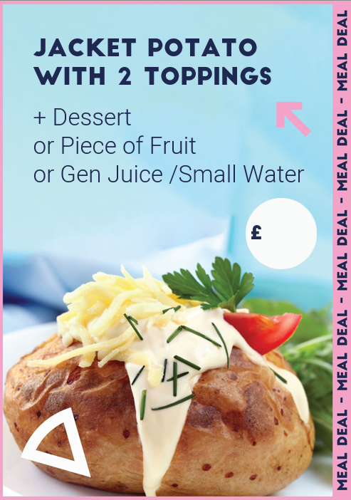
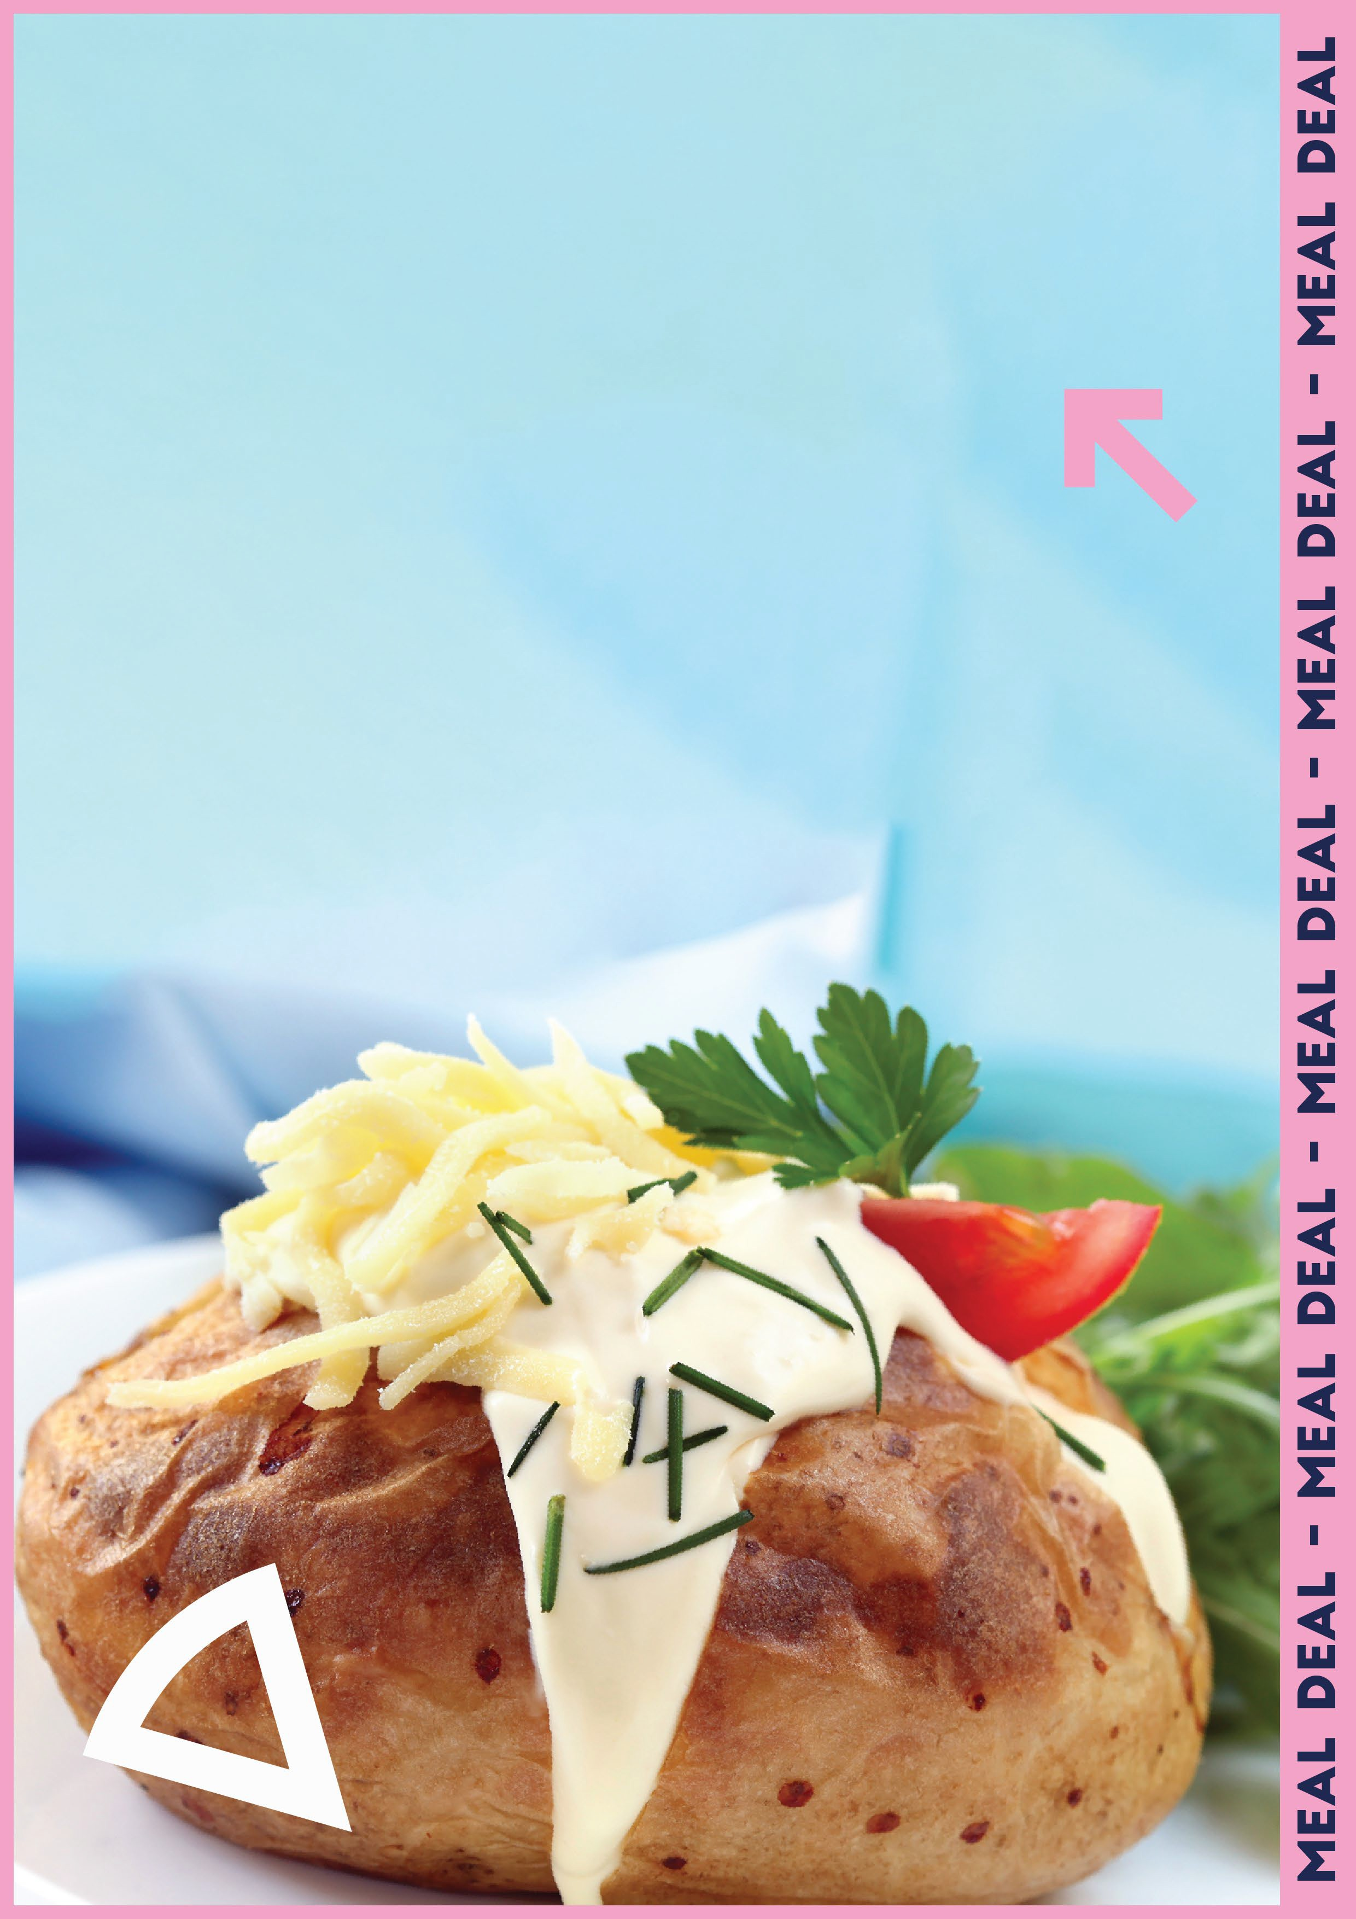
Jacket potato with 2 toppings
+ Dessert
or Piece of Fruit
or Gen Juice /Small Water
2.50

