Slide 1
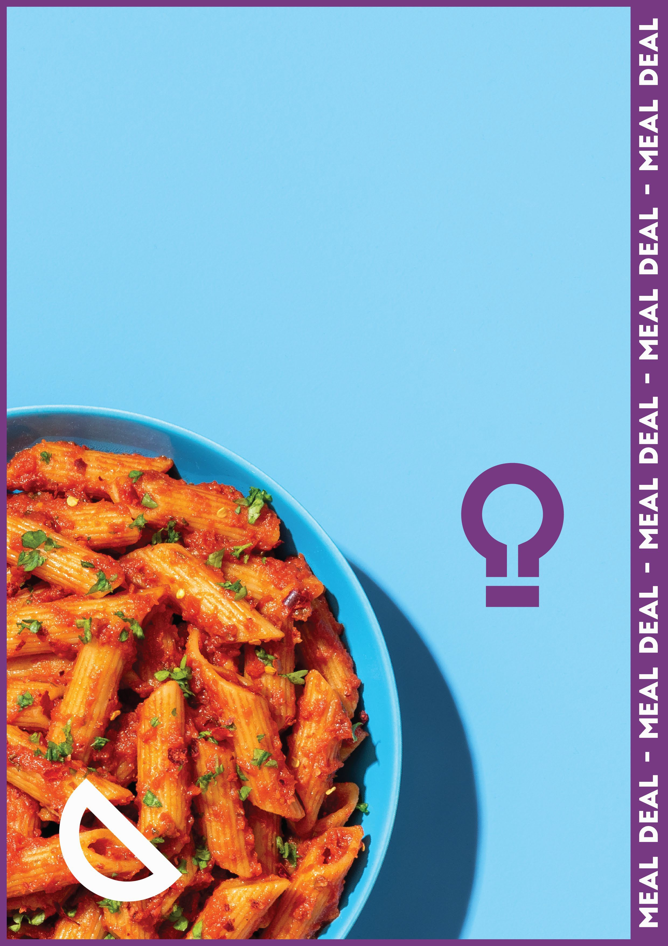
Medium hot pasta
+ Dessert
or Piece of Fruit
Or Small Water
2.50

