Slide 1
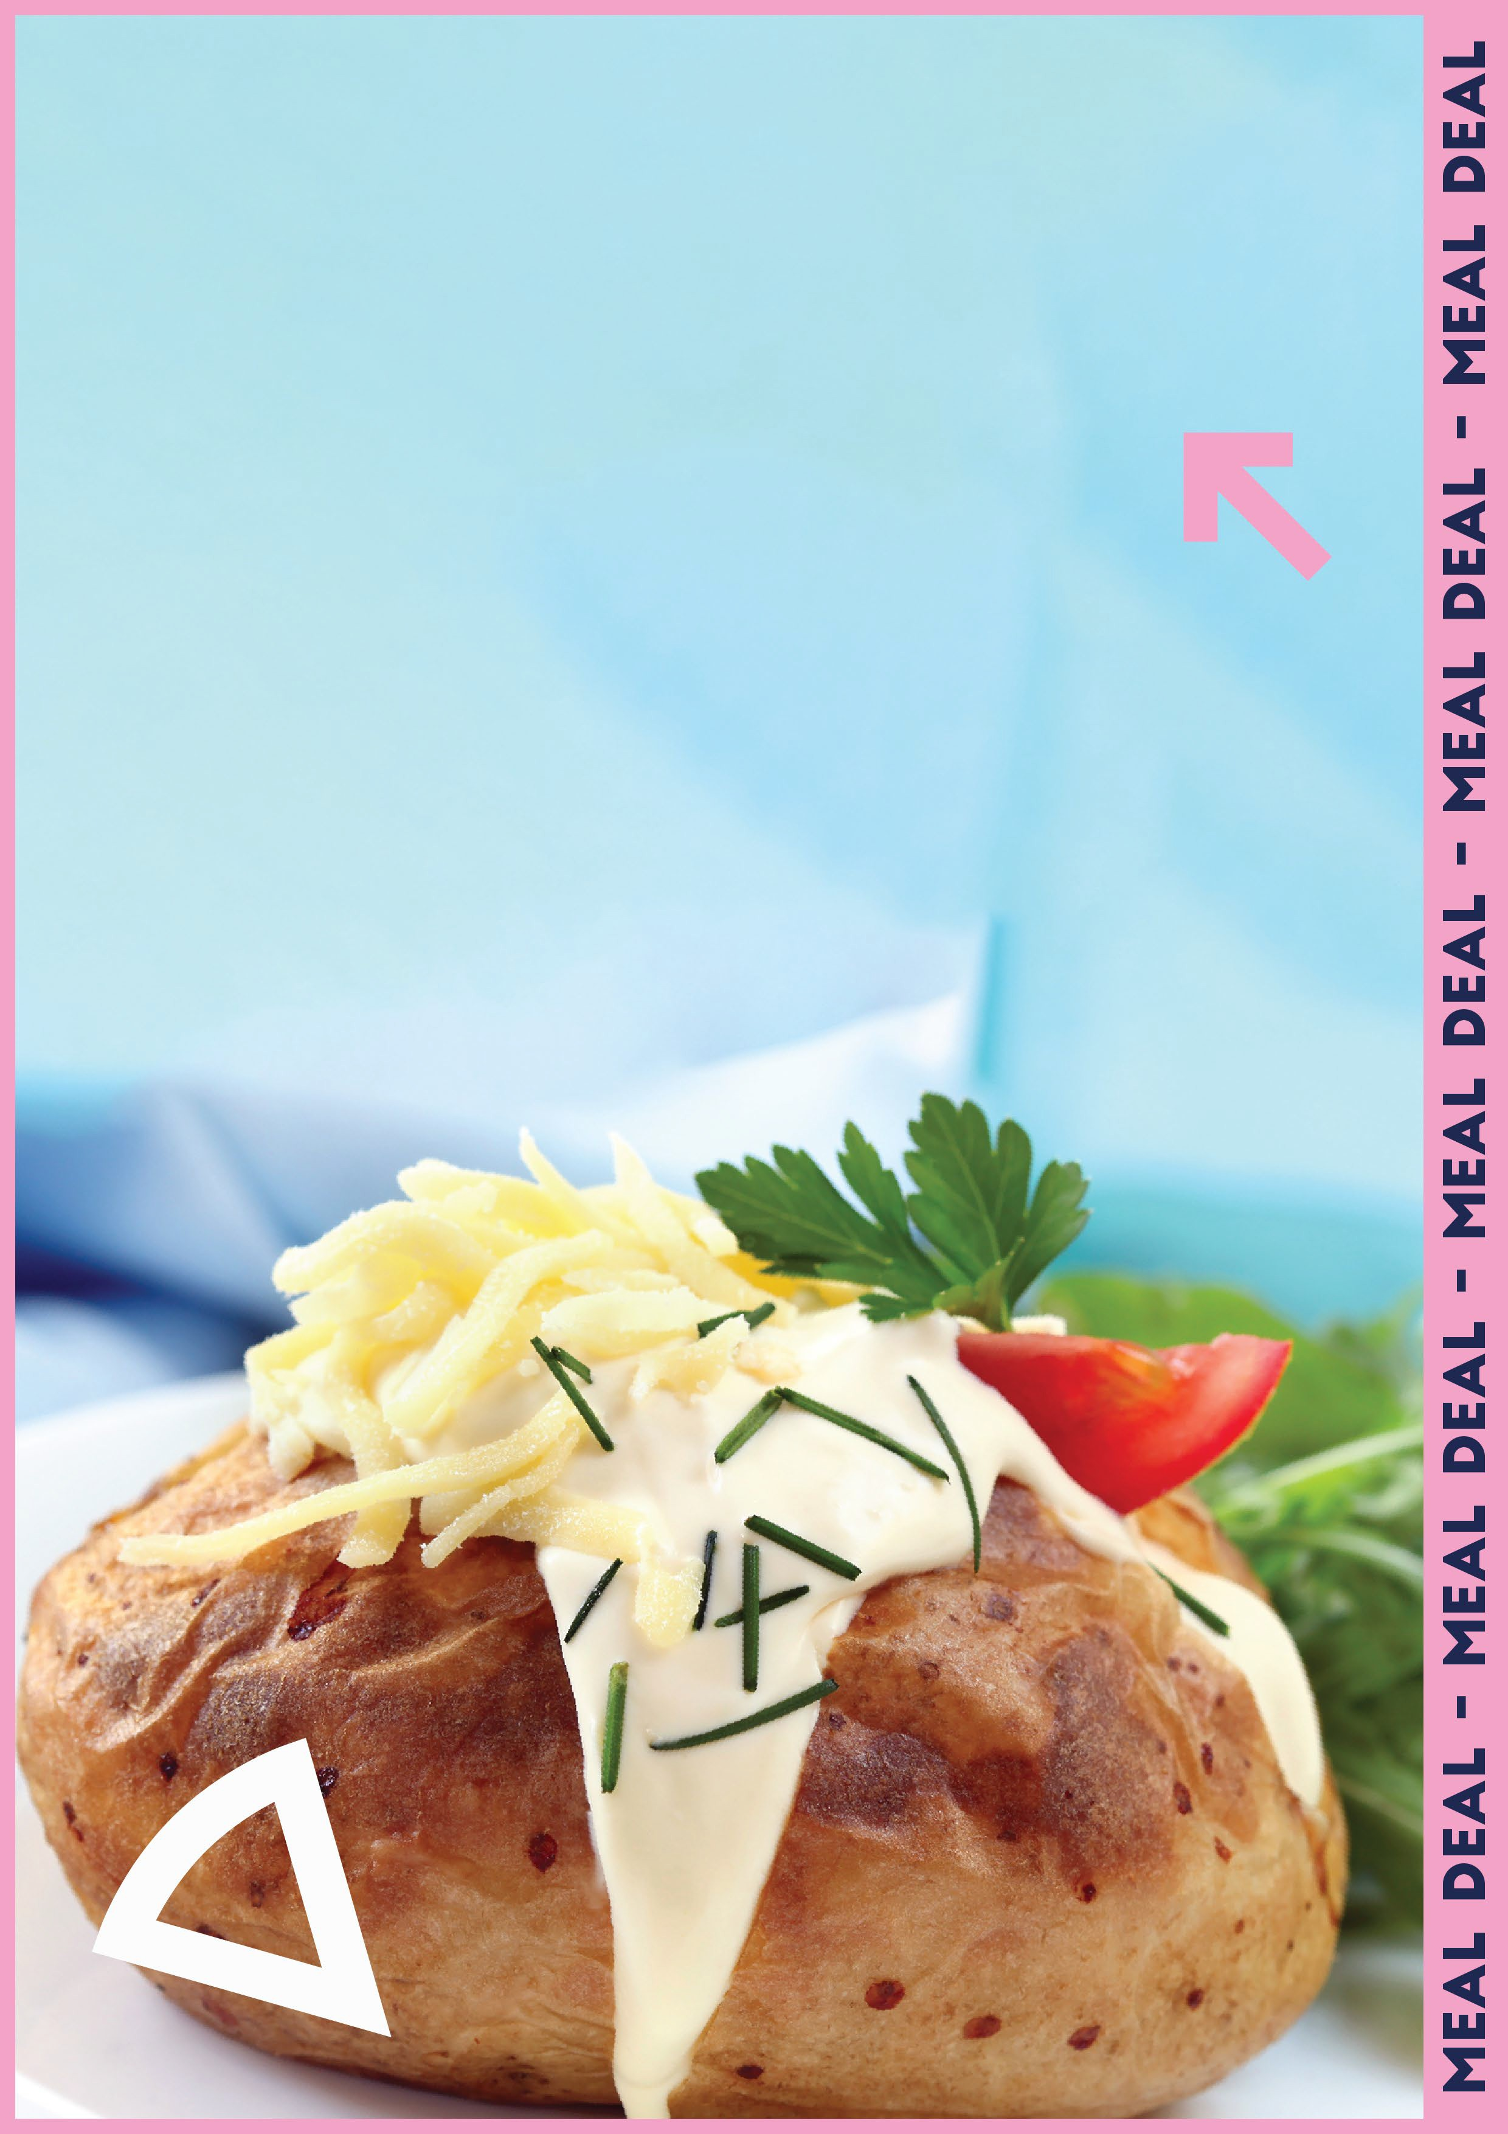
Jacket potato with 2 toppings
+ Dessert
or Piece of Fruit
And Generation juice
2.53

